Slide 1
Week 5 Numerical Simulation of Foams Presentation
By Tony Hau

Slide 2
Objective of this presentation section
To explain how bubbles evolve to equilibrium and to demonstrate Voronoi diagram using python

Slide 3




How do bubbles evolve to equilibrium?
Main reference: http://image.diku.dk/kenny/download/vedel_larsen.10.pdf Quasi-static Simulation of Foam in the Vertex Model

Slide 4
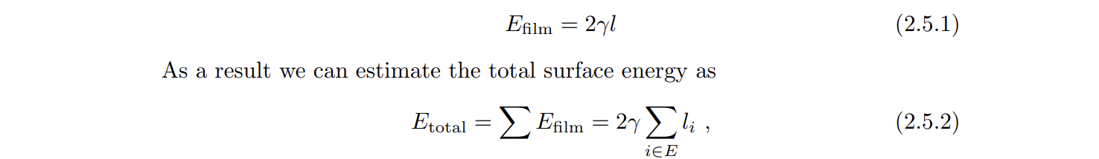
Main driving force behind bubble formation
To minimize total surface energy given area constraint in 2D case.
Energy of a single film is:
Consequence of this result: 120 degree at triple junction (Plateau’s Law)

Slide 5
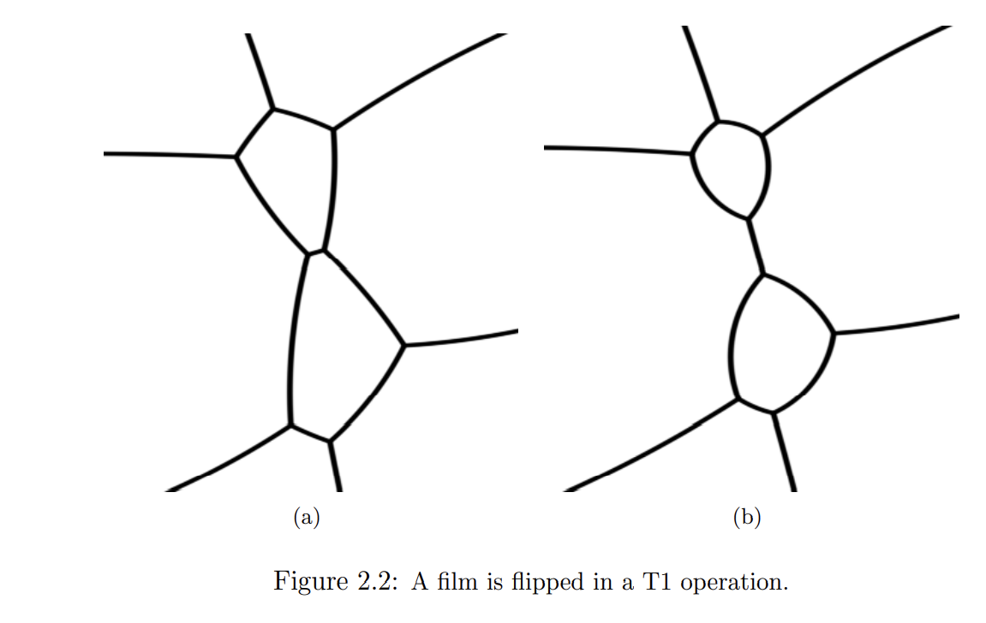
Bubble Topological operations – First operation
1
First operation happens because of the pressure differences between two cells that push two junctions into one junction → unstable because violate Plateau’s triple rule.
4
2
3
Junction

Slide 6
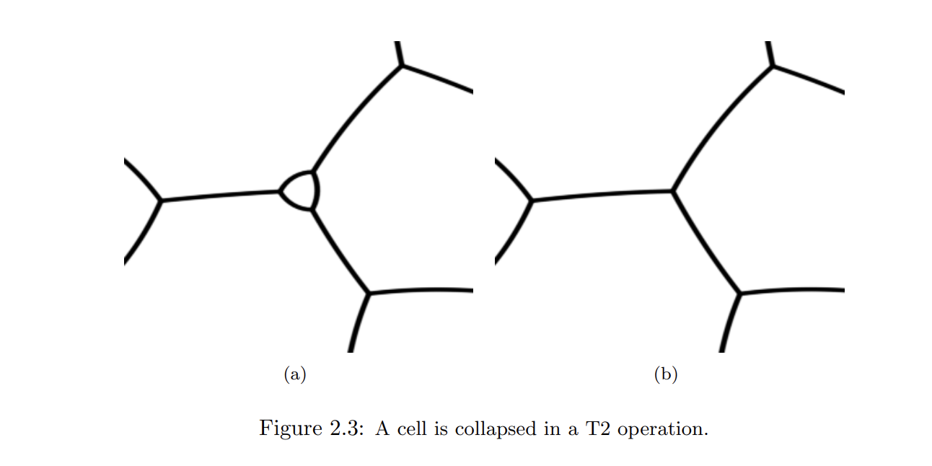

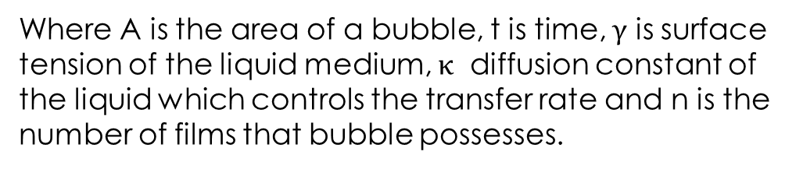
Bubble Topological operations – Second operation
Shrinkage
Second operation occurs because gases escapes from high pressure to low pressure through the shared films
Equation governing change in bubble’s area → von Neumann’s law of diffusion (derived from Laplace Young’s Law and Fick’s law of diffusion)
Where A is the area of a bubble, t is time, $γ$ is surface tension of the liquid medium, $κ$ diffusion constant of the liquid which controls the transfer rate and n is the number of films that bubble possesses.

Slide 7
Implication of von Neumann’s Law of diffusion on second process
Bubble with more than 6 sides → Inflow of gases as dA/dT >0
Bubble with exactly 6 sides → no change in area, very stable
Bubble with less than 6 sides → Shrinkage and outflow of gases
Flow of gases is irrespective of pressure differences or film lengths and curvature, but only sides of a bubble

Slide 8
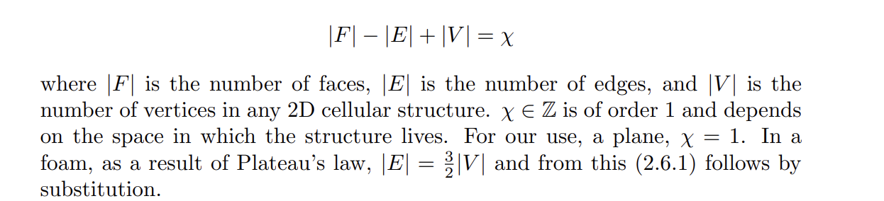
Foam statistics – Euler’s Law
Euler’s Law states that, on average, a bubble should possess 6 films
Distribution of films for an average cell should be symmetric and follows a gaussian, with mean =6

Slide 9
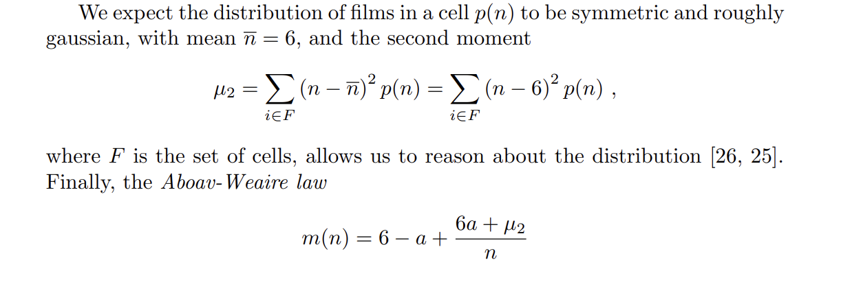
Foam statistics – Aboav – Weaire law

Slide 10
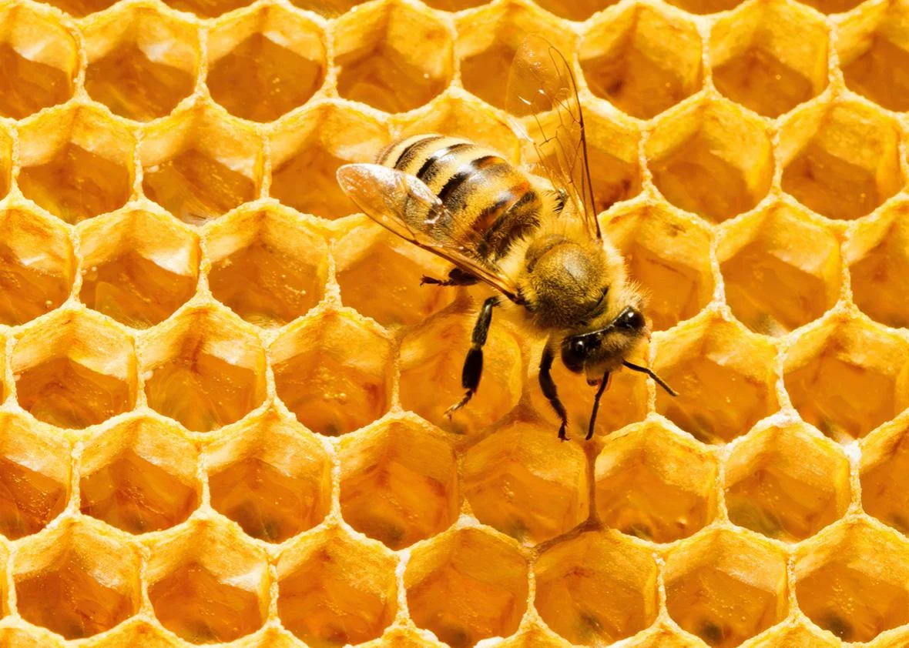
Answering the Question – How does bubble evolve to equilibrium
By Euler’s law, bubbles will tend to evolve to a state where they have 6 sides of film → very similarly to a hexagon honeycomb. However, achievable only when the bubble distribution is infinitely large.
Bubbles with films number smaller than 6 will shrink and those with larger number will grow.
The previous two bubble topological operations dominate the evolution.
Junctions will be 120 degree (Plateau’s Law)
If the bubble distribution is not very large, bubble with six sides will dominate, but some bubbles with different film numbers will surround it(by Aboav – Weaire law)

Slide 11
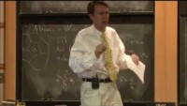
Demonstration of evolution

Slide 12
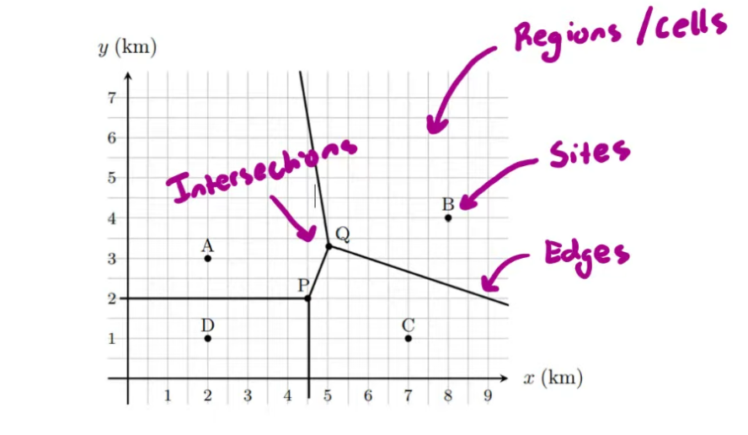
Voronoi Diagram

Slide 13
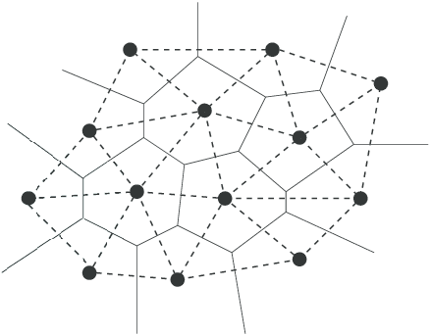
Delaunay triangulation
Line up all the sites – a dual of Voronoi Diagram

Slide 14
Python Code
Source: https://github.com/xrhoffmann/delaunay_voronoi
Technique employed: … Given a set of points in an Euclidean 2D space, we compute the Delaunay triangulation (DT) using the Bowyer-Watson algorithm. We compute the Voronoi tessellation (VT) as the dual graph of the DT.
Input: a set of 100 points(randomly generated positive x y coordinates)
Output: Voronoi and Delaunay diagram

Slide 15

